Slide 1

What makes a country happy?
CS 555 Project by Rayhan Aurelio

Slide 2

Background Statement
I started this assignment in hopes to answer the question to what makes a country truly happy.
We like to measure and compare the success of a country based on various metrics like life expectancy and income.
While no country is perfect, there is obviously something we can all learn in top ranking countries so that we can all live in a happier society

Slide 3
About the Dataset
The dataset used for this assignment is obtained from the World Happiness Report [1]
It contains happiness ranking for every country in between the years 2005-2020
Life Ladder = A score for the happiness a country has in that year
Log GDP per Capita = the logged GDP per capita of every country (to adjust for growth)
Social Support = The score for that country’s social support (how well welfare is)
Healthy Life Expectancy at Birth = Expected lifespan
Freedom to make life choices = How much someone is allowed to make life choices
Generosity = A metric to measure how much the country has donated to charity
Perceptions of corruption = How badly the citizens of said country think corruption in their country is

Slide 4

Methodology
This project will be done in Rstudio.
As all of the independent variables are numeric, I will be performing a linear regression
Given that there is only one dependent variable I will also doing an ANOVA test

Slide 5
What are the best and worst ranked countries (overall)?
Worst – Afghanistan 🇦🇫
Best – Denmark 🇩🇰
Score = 2.375
Year = 2019
Log GDP per Capita = 7.697
Social Support = 0.420
Life Expectancy = 52.4
Freedom Index = 0.394
Generosity = -0.108
Perceptions of corruption = 0.924
Score = 7.971
Year = 2008
Log GDP per Capita = 10.880
Social Support = 0.954
Life Expectancy = 70.08
Freedom index = 0.970
Generosity = 0.272
Perceptions of corruption = 0.248
Difference = 5.596

Slide 6
What are the best and worst ranked countries (Log GDP per capita)?
Worst – Burundi 🇧🇮
Best – Luxembourg 🇱🇺
Score = 3.775
Year = 2018
Log GDP per Capita = 6.635
Social Support = 0.485
Life Expectancy = 53.4
Freedom Index = 0.646
Generosity = -0.024
Perceptions of corruption = 0.599
Score = 7.404
Year = 2019
Log GDP per Capita = 11.648
Social Support = 0.912
Life Expectancy = 72.60
Freedom index = 0.930
Generosity = -0.045
Perceptions of corruption = 0.390
Difference = 3.629

Slide 7
What are the best and worst ranked countries (Social Support)?
Worst – Central African Republic 🇨🇫
Best – New Zealand 🇳🇿
Score = 2.693
Year = 2016
Log GDP per Capita = 6.785
Social Support = 0.290
Life Expectancy = 44.90
Freedom Index = 0.624
Generosity = 0.033
Perceptions of corruption = 0.859
Score = 7.418
Year = 2015
Log GDP per Capita = 10.608
Social Support = 0.987
Life Expectancy = 72.60
Freedom index = 0.942
Generosity = 0.329
Perceptions of corruption = 0.186
Difference = 4.725

Slide 8
What are the best and worst ranked countries (Life Expextancy)?
Worst – Haiti 🇭🇹
Best – Singapore 🇸🇬
Score = 3.766
Year = 2010
Log GDP per Capita = 7.384
Social Support = 0.554
Life Expectancy = 32.300
Freedom Index = 0.373
Generosity = 0.216
Perceptions of corruption = 0.848
Score = 6.378
Year = 2019
Log GDP per Capita = 11.486
Social Support = 0.925
Life Expectancy = 77.10
Freedom index = 0.938
Generosity = 0.027
Perceptions of corruption = 0.070
Difference = 2.612

Slide 9
What are the best and worst ranked countries (Freedom Index)?
Worst – Bosnia and Herzegovina 🇧🇦
Best – Uzbekistan 🇺🇿
Score = 4.963
Year = 2009
Log GDP per Capita = 9.296
Social Support = 0.735
Life Expectancy = 66.480
Freedom Index = 0.258
Generosity = -0.026
Perceptions of corruption = 0.959
Score = 6.421
Year = 2017
Log GDP per Capita = 8.782
Social Support = 0.942
Life Expectancy = 64.80
Freedom index = 0.985
Generosity = 0.123
Perceptions of corruption = 0.465
Difference = 1.458

Slide 10
What are the best and worst ranked countries (Generosity)?
Worst – Greece 🇬🇷
Best – Myanmar 🇲🇲
Score = 5.409
Year = 2018
Log GDP per Capita = 10.299
Social Support = 0.794
Life Expectancy = 72.40
Freedom Index = 0.564
Generosity = -0.335
Perceptions of corruption = 0.860
Score = 4.176
Year = 2013
Log GDP per Capita = 8.230
Social Support = 0.757
Life Expectancy = 57.38
Freedom index = 0.775
Generosity = 0.689
Perceptions of corruption = 0.638
Difference = -1.233

Slide 11
What are the best and worst ranked countries (Perceptions of corruption)?
Worst – Hungary 🇭🇺
Best – Singapore 🇸🇬
Score = 4.725
Year = 2010
Log GDP per Capita = 10.106
Social Support = 0.896
Life Expectancy = 65.50
Freedom Index = 0.514
Generosity = -0.145
Perceptions of corruption = 0.983
Score = 6.145
Year = 2009
Log GDP per Capita = 11.149
Social Support = 0.866
Life Expectancy = 74.50
Freedom index = 0.776
Generosity = -0.075
Perceptions of corruption = 0.035
Difference = 1.42

Slide 12
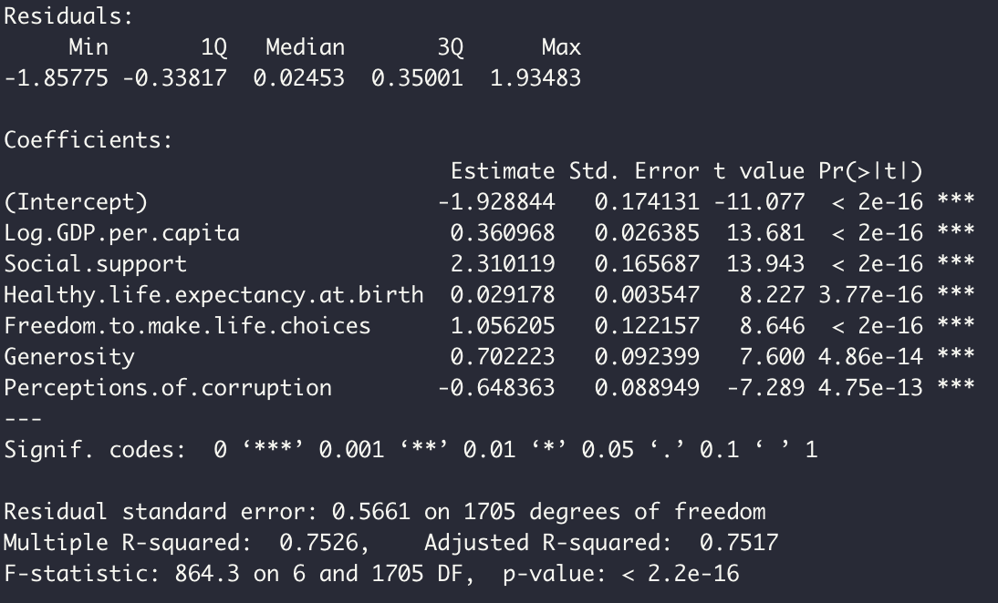
Results - Linear Regression
As we can observe from, the linear regression.
- All of the variables are significant
- Social support looks like to have the most positive correlation
- Perceptions of corruption is the only negatively correlated variable.

Slide 13
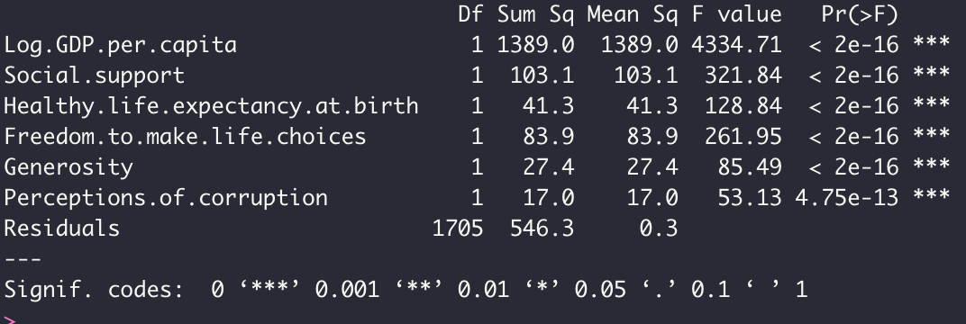
Results - ANOVA Table
The ANOVA table states that all of the variables are significant (p-value less than 0.05)

Slide 14
Conclusions
Based off both of these analyses the variables that contribute the most are as follows (from most to least)
Social Support = Increases by 2.31 for every 1 point increase
Log GDP per Capita = increases by 0.36 for every 1 point increase
Life Expectancy = increase by 0.292 for every 10 year increase after the age of 32
Freedom to make life choices = increases by 0.106 for every 0.1 point increase
Perceptions of Corruption = increases by 0.06 for every 0.1 point decrease
Generosity = increases by 0.007 for every 0.01 point increase

Slide 15
Therefore, a happy country is one which emphasizes the most on social support. In other words, a society which cares for each other.
Thank you for listening!

Slide 16
References
https://worldhappiness.report/

